Slide 1
Java programming #1.1 Intro

Slide 2
Important about Java
Inspired by C/C++
Write once, run anywhere (WORA)
Two-step compilation

Slide 3
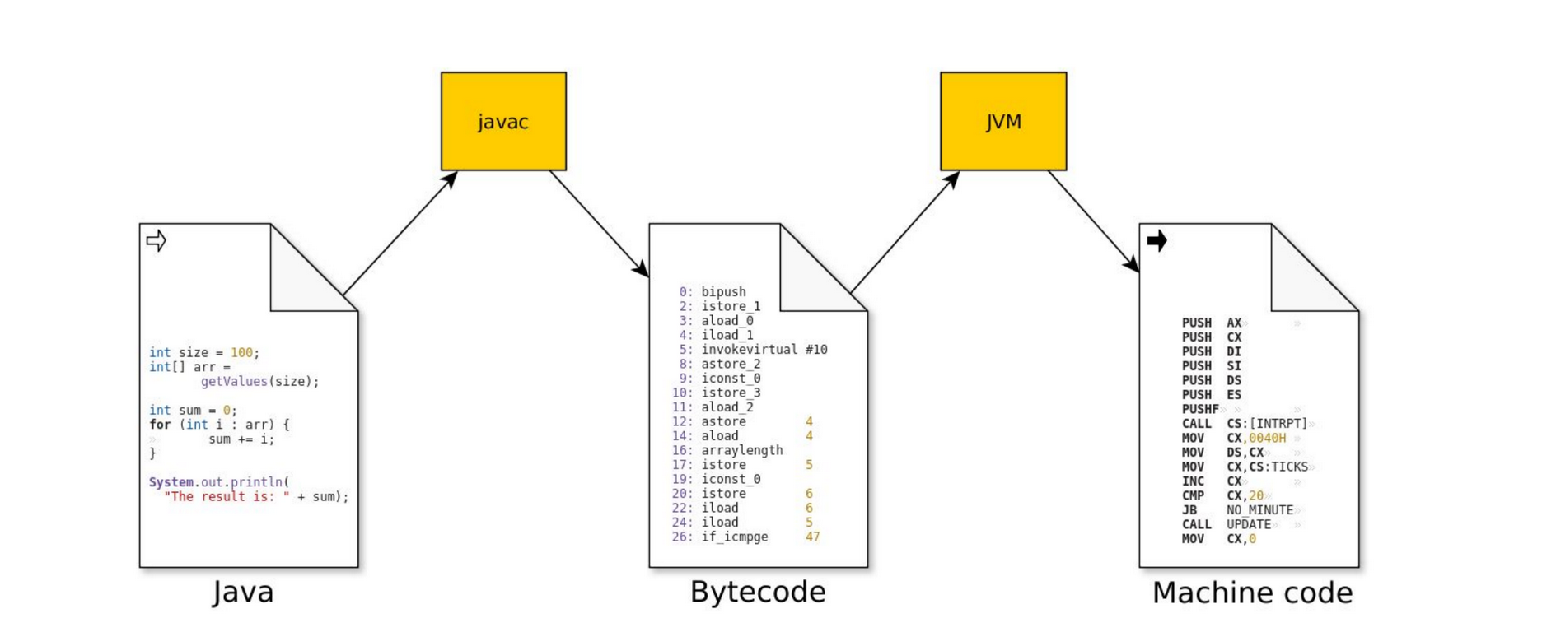
Two-step compilation

Slide 4
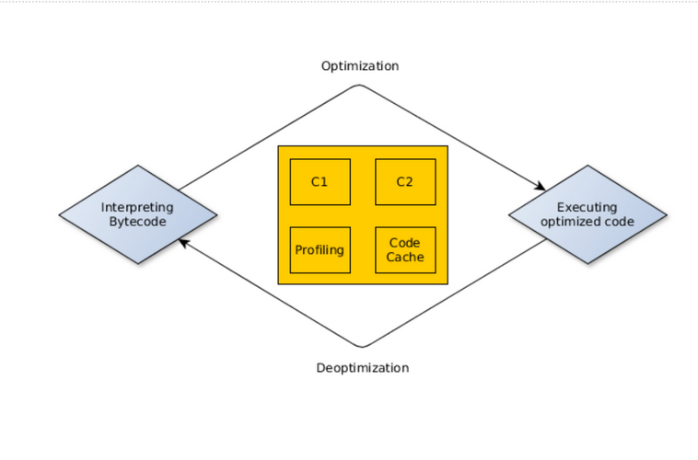
JIT compilation

Slide 5
Garbage collection
Advantages
Less code
Less memory leaks
No invalid links
Disadvantages
No control over GC
Stop The World pauses

Slide 6
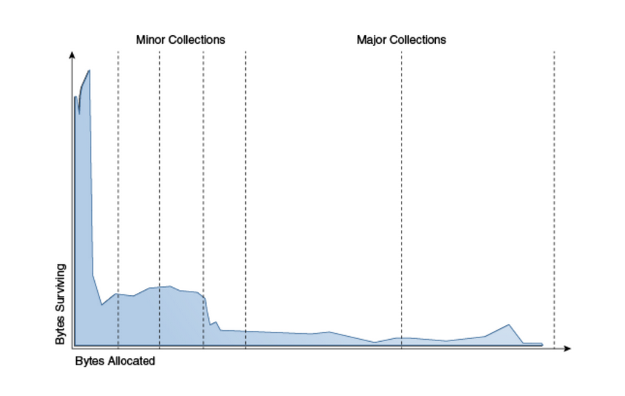
Garbage collection. Generations hypothesis

Slide 7
GC implementations
Serial (for single-threaded, client environments)
Parallel (default)
CMS (Concurrent mark and Sweep — shorter pauses, share processor resources)
G1 (Garbage First — big heaps)
Shenandoah (submillisecond pauses)
Epsilon (no GC)

Slide 8
Standard library
Data structures
Math operations
Date and time
Work with file system
GUI

